Slide 1

Demand Management

Slide 2
HOUSE RULES
Close all laptops unless needed for discussion.
No use of cellphones during the discussion unless there is an emergency.
Questions can be raised during the lecture.
01
02
03

Slide 3
OBJECTIVES
01
02
03
RPA Agile teams will be aware of the RPA CoE Governance Model
04
Maximize benefits of RPA initiatives
Comply with the CoE methodology when managing demand for RPA
Prepare necessary documents for the Demand Management Phase

Slide 4
COURSE OUTLINE
01
Governance Model Overview
02
Demand Management Overview
03
Demand Management Concepts
04
Tools Orientation
05
Exam

Slide 5
COURSE OUTLINE
01
Governance Model Overview
02
Demand Management Overview
03
Demand Management Concepts
04
Tools Orientation
05
Exam

Slide 6
GOVERNANCE
MODEL
02
04
06
DISCOVERY
IMPLEMENTATION
BENEFITS
REALIZATION
Demand Management Process Definition
Delivery
Deployment
01
03
05
IDEATION
SOLUTIONING
OPERATIONS
Transition to Automation
Opportunity Selection
Demand Management (Dev)
Pre-requisite for Dev
Agile Lifecycle
Operations
Support

Slide 7
RPA CoE ORGANIZATION STRUCTURE
CoE Business
CoE Core/ISG
Head of Function
Head of RPA
Continuous Improvement Manager
Delivery Manager
Platform Manager
RPA Evangelist
Process Owner (s)
Product Owner
Scrum Master
Solution Designer
RPA SDM / DevOps Coach
Platform SDM(s)
Business Process SME (s)
Process Analyst
RPA Lead Developer
Process Analyst
Scrum Master
Infra Squad Implementation
RPA L1
DevOps Engineer
Infra Squad Ops
Developer
Tester
RPA Lead Developer
RPA Orchestrator Ops Team
Optional for business
Developer
Tester

Slide 8
IDEATION
DISCOVERY
SOLUTIONING
IMPLEMENTATION
OPERATION
DEMAND MANAGEMENT
(PROCESS)
DEMAND MANAGEMENT (DEVELOPMENT)
CAPACITY MANAGEMENT (PEOPLE)
ROBOT PACKAGE CREATION
TRANSITION TO AUTOMATION
FULFILL SERVICE REQUEST
FULFILL SERVICE REQUEST
CAPACITY MANAGEMENT (PEOPLE)
DEFINE PROCESS REQUIREMENTS
AGILE LIFECYCLE (DEV, TEST)
HANDOVER FOR DEPLOYMENT
PROCESS SELECTION
CREATION OF PDD
CAPACITY MANAGEMENT (SYSTEM)
UAT
CREATE INITIAL BUSINESS CASE
+
UPDATING OF BUSINESS CASE
REQUEST FOR ACCESSES
YES
RELEASE PACKAGE TO PRODUCTION
Approved?
NO
REQUEST FOR INFRA
MONITOR HEARTBEAT OF ROBOTS
NO
Approved?
YES
HYPERCARE PHASE

Slide 9
COURSE OUTLINE
01
Governance Model Overview
02
Demand Management Overview
03
Demand Management Concepts
04
Tools Orientation
05
Exam

Slide 10
Roles & Responsibilities
IDEATION
DISCOVERY
SOLUTIONING
IMPLEMENTATION
OPERATIONS

Slide 11
RACI MATRIX
IDEATION
DISCOVERY
SOLUTIONING
IMPLEMENTATION
OPERATIONS
Process | Function | Development Team | Product Owner | Head of Function | Delivery Manager | Head of RPA
Demand management tool (Process definition pipeline) | Business Group | Independent | R | A | C | I
 |  | Shared | R | A | C | I
 | Domain | Dedicated | R | A | C | I
 |  | Shared | R | A | C | I
Responsible
The team member who does the work to complete the task.
Accountable
The person who delegates work and provides final review on a task or deliverable before it’s deemed complete.
Process | Function | Development Team | Product Owner | Head of Function | Delivery Manager | Platform Manager | Head of RPA
Demand management tool (Development pipeline) | Business Group | Independent | R | A | C | C | I
 |  | Shared | I | I | R | I | A
 | Domain | Dedicated | R | A | C | C | I
 |  | Shared | I | I | R | I | A
Consulted
People who provide input on a deliverable based on the impact on their work or their domain of expertise.
Informed
People who need to be kept in the loop on the progress.

Slide 12

IDEATION
DISCOVERY
SOLUTIONING
IMPLEMENTATION
OPERATIONS
DEMAND MANAGEMENT CONCEPTS

Slide 13
COURSE OUTLINE
01
Governance Model Overview
02
Demand Management Overview
03
Demand Management Concepts
04
Tools Orientation
05
Exam

Slide 14



IDEATION
DISCOVERY
SOLUTIONING
IMPLEMENTATION
OPERATIONS
LAYERS
Demand Management Phases:
Process Definition Pipeline Prioritization
Development Pipeline Prioritization
PRIORITIZATION CRITERIA
PROCESS EXCEPTIONS
Process score which is computed from the agreed criteria during planning.
Some processes may be bypassed in the Demand Management prioritization.

Slide 15
IDEATION
DISCOVERY
SOLUTIONING
IMPLEMENTATION
OPERATIONS
LAYERS
Demand Management Phases:
Process Definition Pipeline Prioritization
Development Pipeline Prioritization

Slide 16

REQUIREMENTS
IMPLEMENTATION
OPERATIONS
IDEATION
DISCOVERY
SOLUTIONING
01
Completed Initial Process Assessment (IPA) Questionnaire
02
Calculated Process Complexity
03
Calculated ROI
04
Approved Initial Business Case
Process Definition Pipeline Prioritization

Slide 17
REQUIREMENTS
IMPLEMENTATION
OPERATIONS
IDEATION
DISCOVERY
SOLUTIONING
Completed Initial Process Assessment (IPA) Questionnaire
Approved Business Case
Calculated Process Complexity
Final Process Definition Document
Calculated ROI
Approved Final Business Case
Development Pipeline Prioritization

Slide 18
IDEATION
DISCOVERY
SOLUTIONING
IMPLEMENTATION
OPERATIONS
PRIORITIZATION CRITERIA
Process score which is computed from the agreed criteria during planning.

Slide 19
Horizontal Level Flat Funnels for PowerPoint
IDEATION
DISCOVERY
SOLUTIONING
IMPLEMENTATION
OPERATIONS
Savings
Revenue
Risk Avoidance
Risks
ECONOMIC IMPACT
50%
Complexity
Effort
COMPLEXITY LEVEL
40%
BATCH NUMBER
Order of which RPA candidates are sent
10%

Slide 20
IDEATION
DISCOVERY
SOLUTIONING
IMPLEMENTATION
OPERATIONS
PROCESS EXCEPTIONS
Some processes may be bypassed in the Demand Management prioritization.

Slide 21


IDEATION
DISCOVERY
SOLUTIONING
IMPLEMENTATION
OPERATIONS
01
Processes with legal implications
02
Management Directive
Mandated by the government
Change in business direction
Scenarios

Slide 22
COURSE OUTLINE
01
Governance Model Overview
02
Demand Management Overview
03
Demand Management Concepts
04
Tools Orientation
05
Exam

Slide 23
IDEATION
DISCOVERY
SOLUTIONING
IMPLEMENTATION
OPERATIONS
TOOLS
ORIENTATION

Slide 24


DEMAND MANAGEMENT TOOL

Slide 25
Setting up the tool
The default weights of each economic impact criteria is 25%. But each business unit can modify this based on their own objectives. While doing this will affect prioritization internally, the default values will be the ones used by the CoE for the development pipeline.
 |  |  | Economic Impact
 |  |  | Saving | 25%
 |  |  | Revenue | 25%
 |  |  | Risk Avoidance | 25%
Weighing |  |  | Risk | 25%
Economic impact | 50%
Complexity Level | 40%
Batch number | 10%
 |  |  | Complexity | Effort | Complexity Level | Development Days
 |  |  | Low | Low | 1 | 7
 |  |  | Low | Medium | 2 | 14
 |  |  | Low | High | 3 | 14
 |  |  | Medium | Low | 4 | 21
 |  |  | Medium | Medium | 5 | 25
 |  |  | Medium | High | 6 | 28
 |  |  | High | Low | 7 | 28
 |  |  | High | Medium | 8 | 35
 |  |  | High | High | 9 | 42

Slide 26
Using the tool
Fill in the name of the process selected for RPA
Process Name | Economic Impact |  |  |  | Complexity Level | Batch number | Process Score
 | Savings | Revenue | Risk Avoidance | Risks

Slide 27
Using the tool
Fill in the name of the process selected for RPA
Process Name | Economic Impact |  |  |  | Complexity Level | Batch number | Process Score
 | Savings | Revenue | Risk Avoidance | Risks
Process A
Process B
Process C

Slide 28
Using the tool
Fill in the economic impact criteria
Process Name | Economic Impact |  |  |  | Complexity Level | Batch number | Process Score
 | Savings | Revenue | Risk Avoidance | Risks
Process A
Process B
Process C

Slide 29
Using the tool
Savings (PHP) – Projected manhours to be saved after RPA multiplied by the rate per hour (annualized)
Revenue (PHP) – Increase in income due to process efficiency (e.g. increase in capacity)
Risk Avoidance (PHP) – Reduction of cost due to mistakes (e.g. cost of rework, cost of good will)
Risk (PHP) – Additional cost in order to ensure other processes are not affected by the automation of the selected process.
Process Name | Economic Impact |  |  |  | Complexity Level | Batch number | Process Score
 | Savings | Revenue | Risk Avoidance | Risks
Process A | PHP 100,000.00 | PHP - | PHP - | PHP -
Process B | PHP 200,000.00 | PHP - | PHP - | PHP -
Process C | PHP 150,000.00 | PHP - | PHP - | PHP 75,000.00

Slide 30
Using the tool
Fill in the complexity level of the selected processes
Process Name | Economic Impact |  |  |  | Complexity Level | Batch number | Process Score
 | Savings | Revenue | Risk Avoidance | Risks
Process A | PHP 100,000.00 | PHP - | PHP - | PHP -
Process B | PHP 200,000.00 | PHP - | PHP - | PHP -
Process C | PHP 150,000.00 | PHP - | PHP - | PHP 75,000.00

Slide 31
Using the tool
This should have been computed using the complexity calculator and matched to the complexity matrix table in the “prioritization criteria weights” sheet
Process Name | Economic Impact |  |  |  | Complexity Level | Batch number | Process Score
 | Savings | Revenue | Risk Avoidance | Risks
Process A | PHP 100,000.00 | PHP - | PHP - | PHP - | 1
Process B | PHP 200,000.00 | PHP - | PHP - | PHP - | 2
Process C | PHP 150,000.00 | PHP - | PHP - | PHP 75,000.00 | 3

Slide 32
Using the tool
Fill in the batch number
Process Name | Economic Impact |  |  |  | Complexity Level | Batch number | Process Score
 | Savings | Revenue | Risk Avoidance | Risks
Process A | PHP 100,000.00 | PHP - | PHP - | PHP - | 1
Process B | PHP 200,000.00 | PHP - | PHP - | PHP - | 2
Process C | PHP 150,000.00 | PHP - | PHP - | PHP 75,000.00 | 3

Slide 33
Using the tool
This should be based on the batching system set by either the CoE or the business units
It is suggested to have a monthly cut-off to determine the batch number
This can be changed as the CoE matures
Process Name | Economic Impact |  |  |  | Complexity Level | Batch number | Process Score
 | Savings | Revenue | Risk Avoidance | Risks
Process A | PHP 100,000.00 | PHP - | PHP - | PHP - | 1 | 1
Process B | PHP 200,000.00 | PHP - | PHP - | PHP - | 2 | 1
Process C | PHP 150,000.00 | PHP - | PHP - | PHP 75,000.00 | 3 | 1

Slide 34
Using the tool
The process score will be computed
This should be the basis for prioritization
Process B being the first priority followed by process A and process C to be the least priority
Process Name | Economic Impact |  |  |  | Complexity Level | Batch number | Process Score
 | Savings | Revenue | Risk Avoidance | Risks
Process A | PHP 100,000.00 | PHP - | PHP - | PHP - | 1 | 1 | 53.33%
Process B | PHP 200,000.00 | PHP - | PHP - | PHP - | 2 | 1 | 60.00%
Process C | PHP 150,000.00 | PHP - | PHP - | PHP 75,000.00 | 3 | 1 | 36.67%

Slide 35
Using the tool
Delete the processes that have already started in the next phase (PDD creation or Development) before starting another demand management cycle
Process Name | Economic Impact |  |  |  | Complexity Level | Batch number | Process Score
 | Savings | Revenue | Risk Avoidance | Risks
Process A | PHP 100,000.00 | PHP - | PHP - | PHP - | 1 | 1 | 53.33%
Process C | PHP 150,000.00 | PHP - | PHP - | PHP 75,000.00 | 3 | 1 | 36.67%

Slide 36


PROCESS EXCEPTION TEMPLATE

Slide 37
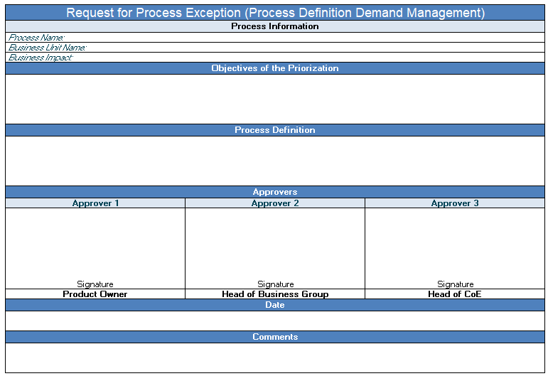
Using the template
Fill in the necessary information to give the approvers an idea on why the process has to be prioritized

Slide 38
Using the template
Approvers will vary depending on which stage of demand management we’re in

Slide 39
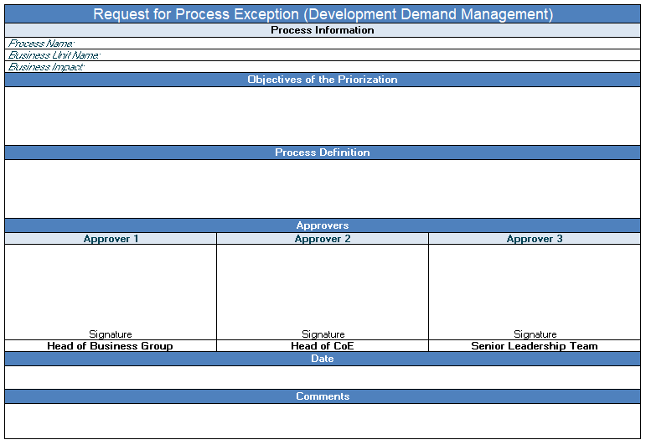
Using the template
For the PDD prioritization - Product Owner, Head of Business Group and Head of CoE should be the approvers
For the development prioritization – Head of Business Group, Head of CoE and Senior Leadership Team should be the approvers

Slide 40
COURSE OUTLINE
01
Governance Model Overview
02
Demand Management Overview
03
Demand Management Concepts
04
Tools Orientation
05
Exam

Slide 41


